Slide 1
INTRODUCTION AI & ML WITH PYTHON
Name of the student: Perala.Chandrika Ratna(Y20ADS421)
Podapatti.Greeshma Sanjana(Y20ADS423)
Department Name : Department of Cyber Security & Data Science
Branch:Data Science

Slide 2
Project Topic
Hate Speech Detection
1.Abstract:
As per our Esteemed Institution BEC Curriculum Guidelines , I have undergone my Internship Project conducted by the Company 1 Stop Keep Growing from 15th May 2023 to 15th July 2023(08 weeks).
The main objective of preparing this report is to be aware of Machine Learning and it’s Coding. During the 08-weeks of Internship training , I have learnt the Basic Knowledge of Machine Learning Topics and Operating Code of Machine Learning Using Python Libraries. This report presents 5 chapters which have Different Activities and Issues Discussed from the field including the Following.

Slide 3
Chapter One consists of Introduction To Machine Learning , Definitions , Importance & Applications of Machine Learning .
Chapter Two consists of Introduction to Python , and introduction to libraries like Pandas.
Chapter Three consists of Steps in developing ML Model , Linear Regression, Logistic Regression and KNN.
Chapter Four consists of Naive Bayes, Clustering, K-means clustering.
Chapter Five consists of Supervised Learning , Semi-Supervised Learning and Unsupervised Learning.

Slide 4
Finally My Project in Internship Training is on the Topic “HATE SPEECH DETECTION”. Hate speech detection is the model which identifies and detects hateful and offensive speech being poured on the internet. Most of the approaches used for hate speech detection tasks are supervised methods. We had achieved 90% accuracy on the validation data which is quite sufficient to prove the power of supervised models in NLP-related tasks.

Slide 5
2.Existing System: Existing System is nothing but that how many types we used in the process of Implementing Our Project Work. My Project Topic : HATE SPEECH DETECTION is operated by using the Supervised Methods. We use dataset in this method and the dataset consists of Twitter hate speech detection data, used to research hate-speech detection. The text in the data is classified as hate speech, offensive language, and neither . Some of the libraries we use in this project are pandas , scikit learn, and The Natural Language Toolkit) library, used for symbolic and

Slide 6
statistical natural language processing for English written in the Python programming language. 3.Proposed System: In My project I used NLTK because NLTK (Natural Language Toolkit) is the go-to API for Natural Language Processing)with Python. It is a really powerful tool to preprocess text data for further analysis like with ML models for instance. It helps convert text into numbers, which the model can then easily work with.

Slide 7
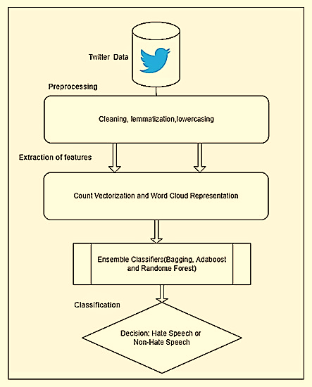
4.Flowchart

Slide 8
5.Project Code: Hate speech detection is the model which identifies and detects hateful and offensive speech being poured on the internet. So hate speech detection has become an important solution to problems in today’s online world. The steps in building a Hate Speech Detection Project is: 1)Set up the development environment 2)Understand the data 3)Import the required libraries 4)Preprocess the data 5)Split the data 6)Build the model 7)Evaluate the results

Slide 9
Step 1: Set up the development environment The first major step is to set up the development environment for building a Hate Speech detection project. For developing a Hate Speech detection project you should have the system with anaconda navigator notebook software installed. Else , you can also use gogglehttps://colab.research.google.com/ for developing this project. Step 2: Understanding the data The dataset for building our hate speech detection model is available on www.kaggle.com. The dataset consists of Twitter hate speech detection data, used to research hate-speech detection. The text in the data is classified as hate speech, offensive language, and neither.

Slide 10
You can find the dataset for hate speech detection here https://www.kaggle.com/datasets/mrmorj/hate-speech-and-offensive-language-dataset There are 7 columns in the hate speech detection dataset. They are index, count, hate _ speech , offensive _ language, neither, class and tweet. The description of the column is as follows: index – This column has the index value. count– It has the number of users who coded each tweet. hate _ speech – This column has the number of users who judged the tweet to be hate speech. offensive _ language – It has the number of users who judged the tweet to be offensive neither – This has the number of users who judged the tweet to be neither offensive nor non-offensive

Slide 11
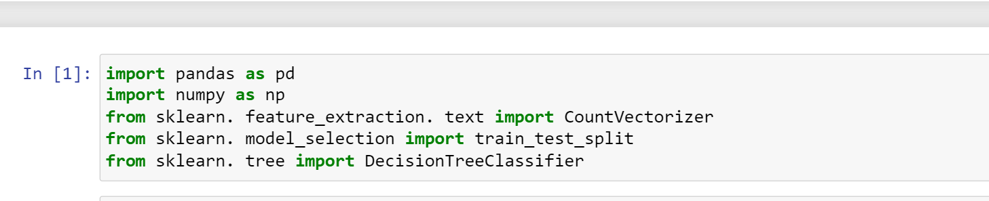
class – it has a class label for the majority of the users, in which 0 denotes hate speech, 1 means offensive language and 2 denotes neither of them. tweet – This column has the text tweet. Step 3:Importing the required libraries After analyzing the data our next step is to import the required libraries for our project. Some of the libraries we use in this project are pandas, scikit learn, and NLTK.
.

Slide 12
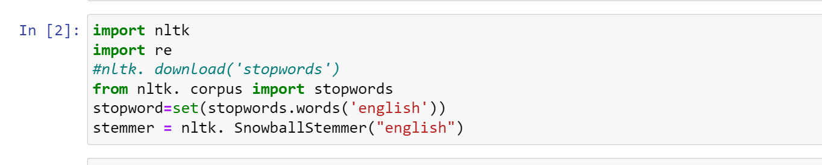
We are going to import NLTK( The Natural Language Toolkit) library, used for symbolic and statistical natural language processing for English written in the Python programming language.

Slide 13
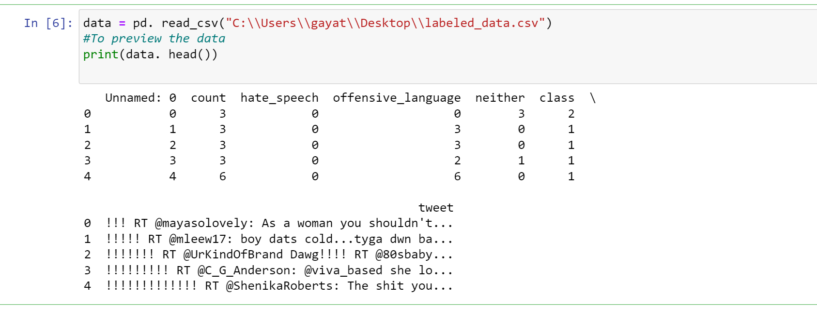

Slide 14
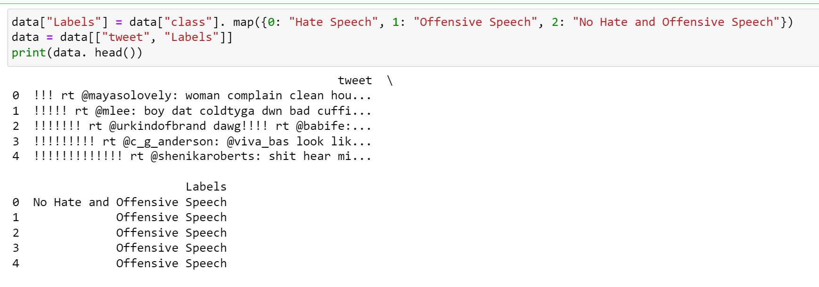
Step4: Preprocessing the data In Data preprocessing, we prepare the raw data and make it suitable for a machine learning model.

Slide 15
When creating a machine learning project, it is not always a case that we come across clean and formatted data. And while doing any operation with data, it is mandatory to clean it and put it in a formatted way. So for this, we use the data preprocessing task. We have used two important Natural Language processing terms, stopword and stemmer. Stopwords are the useless words (data), in natural language processing. We can avoid those words from the input. Stemming is the process of producing morphological variants of a root word. We have to find the stem word for each text better and easy prediction.

Slide 16
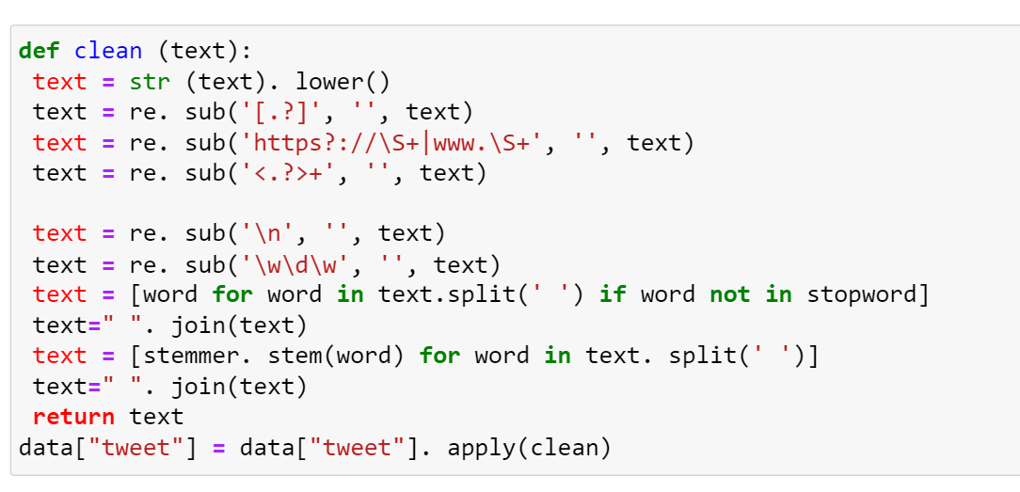

Slide 17
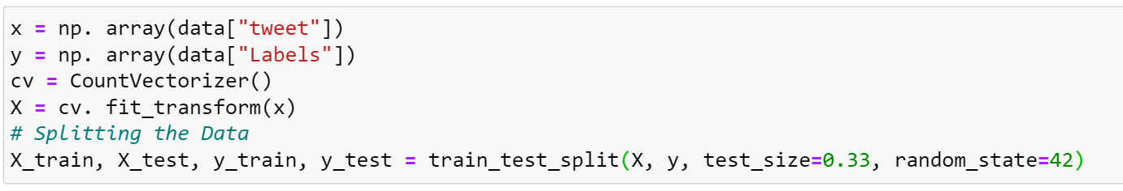
Step5:Splitting the data The next important step is to explore the dataset and divide the dataset into training and testing data.

Slide 18
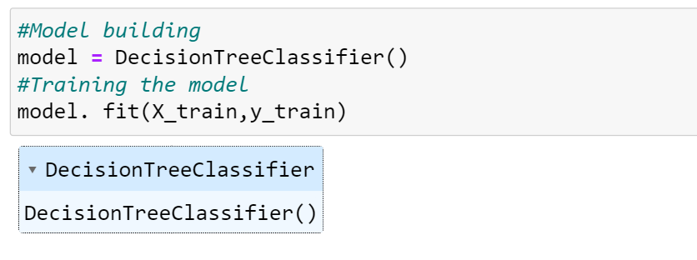
Step6:Building the model After segregating the data, our next work is to find a good algorithm suited for our model. We can use a Decision tree classifier for building the Hate Speech detection project.

Slide 19
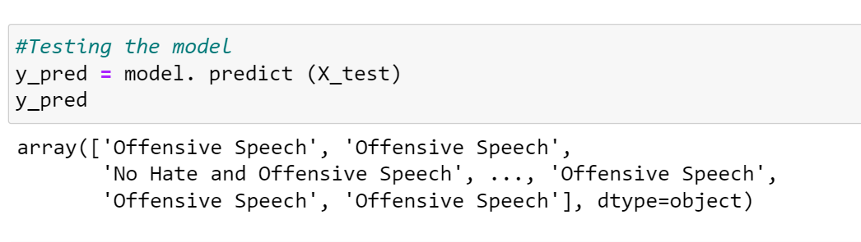
Step7:Evaluating the results The final step in machine learning model building is prediction. In this step, we can measure how well our model performs for the test input.

Slide 20
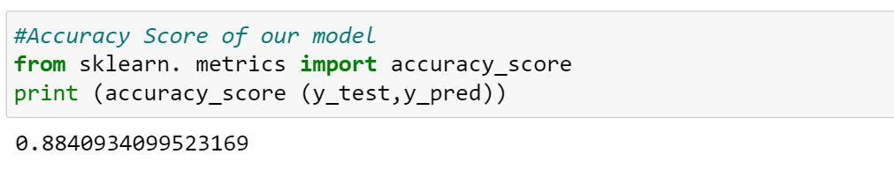
We can infer that our model for Hate speech detection performs with an accuracy of 88 percent.

Slide 21
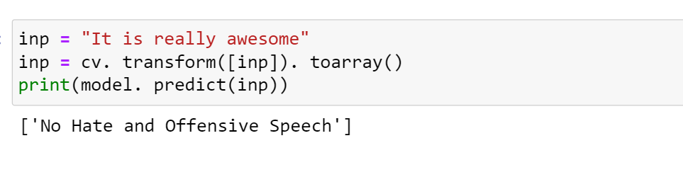

Slide 22
6.References: While Doing my Internship Project I used The Following References: 1)Internet 2)Other Online Videos On Machine Learning Project Coding. 3)Consulting My mentor and Lecturers. 4)Guidelines from Our Seniors.

Slide 23


